Slide 1
Discrete Mathematics
What is Set?
Set & Ven diagrams – Lesson 5
February 19th, 2016

Slide 2
A set is said to contain its elements.
A set is an unordered collection of objects, called elements or members of the set.
{1, 2, 3} is the set containing “1” and “2” and “3.” list the members between braces.
{1, 1, 2, 3, 3} = {1, 2, 3} since repetition is irrelevant.
{1, 2, 3} = {3, 2, 1} since sets are unordered.
{1,2,3, …, 99} is the set of positive integers less than 100
{1, 2, 3, …} is a way we denote an infinite set (in this case, the natural numbers).
∅ = {} is the empty set, or the set containing no elements.
Note: ∅ ≠ {∅}

Slide 3
Some examples
The set V of all vowels in the English alphabet V = {a, e, i, o, u}.
The set of positive integers less than 100 can be denoted by {1, 2, 3, . . . , 99}. ellipses (. . .) are used when the general pattern of the elements is obvious.
{a, 2, Fred, New Jersey} is the set containing the four elements a, 2, Fred, and New Jersey.

Slide 4
Element of Set
A set is an unordered collection of objects referred to as elements.
A set is said to contain its elements. We write a ∈ A to denote that a is an element of the set A.
The notation a ∈ A denotes that a is not an element of the set A.

Slide 5
Try Yourself
Let A = {1, 3, { { 1,2}, ø},{ø } }. State whether the following statements are true or not. Give reason.
{{1, 2},{ø } } ϵ A
{1, 4,{ø } } ϵ A
ø ϵ A

Slide 6
Some Sets
N = {0,1,2,3,…}, the set of natural numbers, non negative integers, (occasionally IN)
Z = { …, -2, -1, 0, 1, 2,3, …), the set of integers
Z⁺ = {1,2,3,…} set of positive integers
Q = {p/q | p ∈ Z, q ∈Z, and q≠0}, set of rational numbers
R, the set of real numbers
R+, the set of positive real numbers
C, the set of complex numbers.

Slide 7
Set builder notation
Another way to describe a set is to use set builder notation.
O = {x | x is an odd positive integer less than 10}
or, specifying the universe as the set of positive integers, as
O = {x ∈ Z+ | x is odd and x < 10}.

Slide 8
Empty Set
There is a special set that has no elements. This set is called the empty set,or null set, and is denoted by ∅. The empty set can also be denoted by { }
Common error is to confuse the empty set ∅ with the set {∅}
The empty set can be thought of as an empty folder and the set consisting of just the empty set can be thought of as a folder with exactly one folder inside, namely, the empty folder.
Determine whether these statements are true or false.
a) ∅ ∈ {∅} b) ∅ ∈ {∅, {∅}}
c) {∅} ∈ {∅} d) {∅} ∈ {{∅}}

Slide 9
Subset
The set A is a subset of B if and only if every element of A is also an element of B. We use the notation
A ⊆ B to indicate that A is a subset of the set B.

Slide 10
Ven diagram of Subset
U
B
A
Fig: A Is a Subset of B.

Slide 11
Try Yourself
Let A = {1, 5, { { 1,2}, ø},{ø } }. State whether the following statements are true or not. Give reason.
{1, 3, ø} ⊆ A
{1, 5, ø} ⊆ A
{ } ⊆ A

Slide 12
Proper subset
When we wish to emphasize that a set A is a subset of a set B but that
A = B, we write A ⊂ B and say that A is a proper subset of B.
∀x(x ∈ A → x ∈ B) ∧ ∃x(x ∈ B ∧ x ∈ A)

Slide 13
Try Yourself
A is the set of prime numbers less than 10 , B is the set of odd numbers less than 10, C is the set of even numbers less than 10. How many of the following statements are true? Explain
i. A ⊂B Is ∀x(x ∈ A → x ∈ B) ∧ ∃x(x ∈ B ∧ x ∈ A) true?
ii. B ⊂ A
iii. A ⊂ C
iv. C ⊂ A
v. B ⊂ C
vi. C ⊂ A
Prime numbers less than 10 are: 2,3,5,7

Slide 14
Set Theory - Definitions and notation
A few more:
Is {a} ⊆ {a}?
Yes
Is {a} ∈ {a,{a}}?
Yes
Is {a} ⊆ {a,{a}}?
Yes
Is {a} ∈ {a}?
No

Slide 15
Power set
The power set of S is denoted by P(S).
The power set P({0, 1, 2}) is the set of all subsets of {0, 1, 2}. Hence,
P({0, 1, 2}) = {∅, {0}, {1}, {2}, {0, 1}, {0, 2}, {1, 2}, {0, 1, 2}}.
Note that the empty set and the set itself are members of this set of subsets.

Slide 16
Examples
If S is a set, then the power set of S is 2^{S} = { x : x ⊆ S }.
If S = {a},
We say, “P(S) is the set of all subsets of S.”
2^{S} = {∅, {a}}.
If S = {a,b},
2^{S} = {∅, {a}, {b}, {a,b}}.
If S = ∅,
2^{S} = {∅}.
If S = {∅,{∅}},
2^{S} = {∅, {∅}, {{∅}}, {∅,{∅}}}.
Why?
Fact: if S is finite, |2^{S}| = 2^{|S|}. (if |S| = n, |2^{S}| = 2^{n})

Slide 17
Set Theory - Definitions and notation
Quick examples:
{1,2,3} ⊆ {1,2,3,4,5}
{1,2,3} ⊂ {1,2,3,4,5}
Is ∅ ⊆ {1,2,3}?
Yes! ∀x (x ∈ ∅) → (x ∈ {1,2,3}) holds (for all over empty domain)
Is ∅ ∈ {1,2,3}?
No!
Is ∅ ⊆ {∅,1,2,3}?
Yes!
Is ∅ ∈ {∅,1,2,3}?
Yes!

Slide 18
Set operators
The union of two sets A and B is:
A ∪ B = { x : x ∈ A v x ∈ B}
If A = {Charlie, Lucy, Linus},
B = {Lucy, Desi}, then
A ∪ B = {Charlie, Lucy, Linus, Desi}
B
A

Slide 19
Set Theory - Operators
The intersection of two sets A and B is:
A ∩ B = { x : x ∈ A ∧ x ∈ B}
If A = {Charlie, Lucy, Linus}, and B = {Lucy, Desi}, then
A ∩ B = {Lucy}
B
A

Slide 20
Set Theory - Operators
The intersection of two sets A and B is:
A ∩ B = { x : x ∈ A ∧ x ∈ B}
If A = {Rice, Vegetables}, and B = {Beef, Chicken}, then
A ∩ B = {} = ∅
Sets whose intersection is empty are called disjoint sets
B
A
20

Slide 21
Set Theory - Operators
The complement of a set A is: A = { x : x ∉ A}
If A = {x : x is at home}, then
A = {x : x is not at home}
= U and
U = ∅
U
A
A = U – A, where U is the universal set.

Slide 22
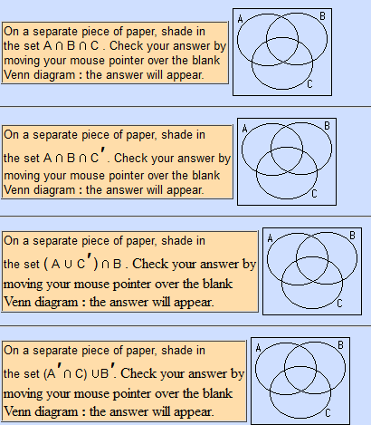
Identify the sets by shading

Slide 23
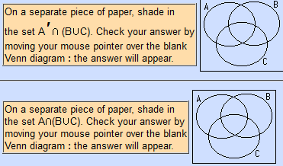
Identify the sets by shading

Slide 24
Check your answer
http://math.uww.edu/~mcfarlat/143venn.htm

